Slide 1

Naïve Bayes Classifier

Slide 2
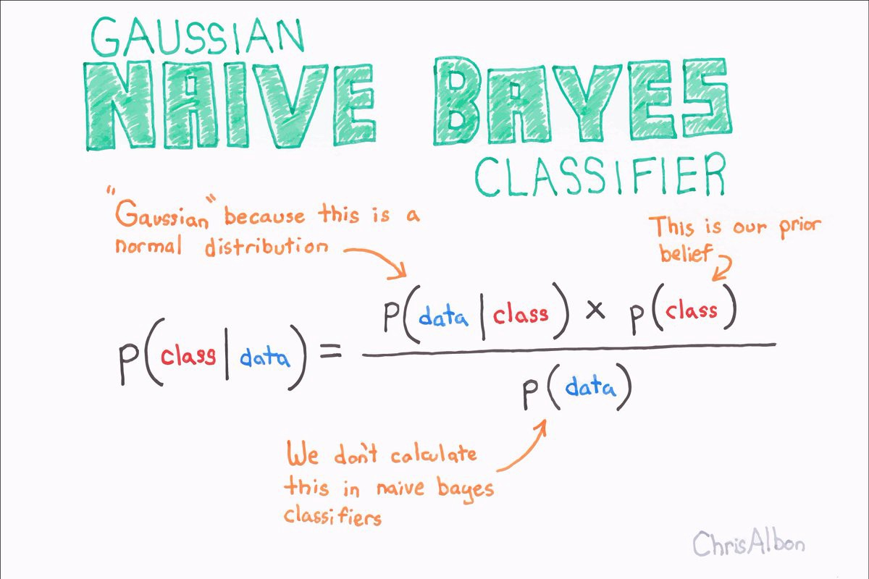

Slide 3

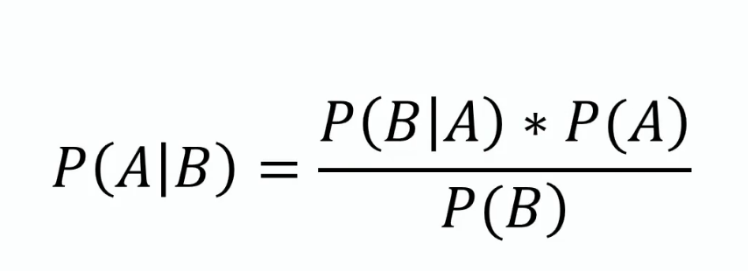
Thomas Bayes

Slide 4
Fruit = {Yellow, Sweet, Long}
Fruit | Yellow | Sweet | Long | Total
Orange | 350 | 450 | 0 | 650
Banana | 400 | 300 | 350 | 400
Others | 50 | 100 | 50 | 150
Total | 800 | 850 | 400 | 1200

Slide 5
P(Yellow/Orange) = P(Oranges/Yellow).P(Yellow)
P(Oranges)
Fruit | Yellow | Sweet | Long | Total
Orange | 350 | 450 | 0 | 650
Banana | 400 | 300 | 350 | 400
Others | 50 | 100 | 50 | 150
Total | 800 | 850 | 400 | 1200
350 X 800
=
800 1200
650
1200
P(Yellow/Orange) = 0.5
P(Sweet/Orange) = 0.69
P(Long/Orange) = 0

Slide 6

P(Fruit / Orange) = 0.53 * 0.69 * 0 = 0
P(Fruit / Banana) = 1 * 0.75 * 0.87 = 0.65
P(Fruit / Others) = 0.33 * 0.66 * 0.33 = 0.072
Answer is Banana fruit = 0.65
Because of Highest probability

Slide 7
Fruit | Yellow | Sweet | Long | Total
Orange | 350 | 450 | 0 | 650
Banana | 400 | 300 | 350 | 400
Others | 50 | 100 | 50 | 150
Total | 800 | 850 | 400 | 1200
Let’s Code

